Slide 1
Locality Analysis
By Neel Shah

Slide 2

Introduction
Analysing Localities based on data from Zomato API, and recommending localities based on given parameters.

Slide 3

The problem statement states that given a dataset consisting restaurants, cuisines served, and their coordinates, we need to identify similar localities, based on which localities prefer a similar kind of cuisines. Similar cuisines add to the similarity of two localities, and using K Means clustering, we can identify clusters with similar localities. A cluster can have localities with different “1st popular cuisine”, but there can be other less popular cuisines that contribute to their similarity.

Slide 4

Restaurants can often be used to analyse localities. Our analysis can be extended to recommending localities to new and upcoming restaurants, and giving them alternative cuisines to try in these localities. The analysis can also be extended to analyse the average spending or the localities that have similar restaurants in terms of probable average spending.
Food being a very integral part of our cultures, should give us neighbourhoods/localities that are similar to each other, with an acceptable accuracy.
Most of the restaurant businesses would be interested in this model and its analysis.

Slide 5

Data
The data we use has the following columns.
Every Restaurant contains the following variables:
• Restaurant Id: Unique id of every restaurant across various cities of the world • Restaurant Name: Name of the restaurant • Country Code: Country in which restaurant is located • City: City in which restaurant is located • Address: Address of the restaurant • Locality: Location in the city • Locality Verbose: Detailed description of the locality • Longitude: Longitude coordinate of the restaurant's location • Latitude: Latitude coordinate of the restaurant's location • Cuisines: Cuisines offered by the restaurant • Average Cost for two: Cost for two people in different currencies • Currency: Currency of the country • Has Table booking: yes/no • Has Online delivery: yes/ no • Is delivering: yes/ no • Switch to order menu: yes/no • Price range: range of price of food • Aggregate Rating: Average rating out of 5 • Rating colour: depending upon the average rating colour • Rating text: text on the basis of rating of rating • Votes: Number of ratings casted by people

Slide 6
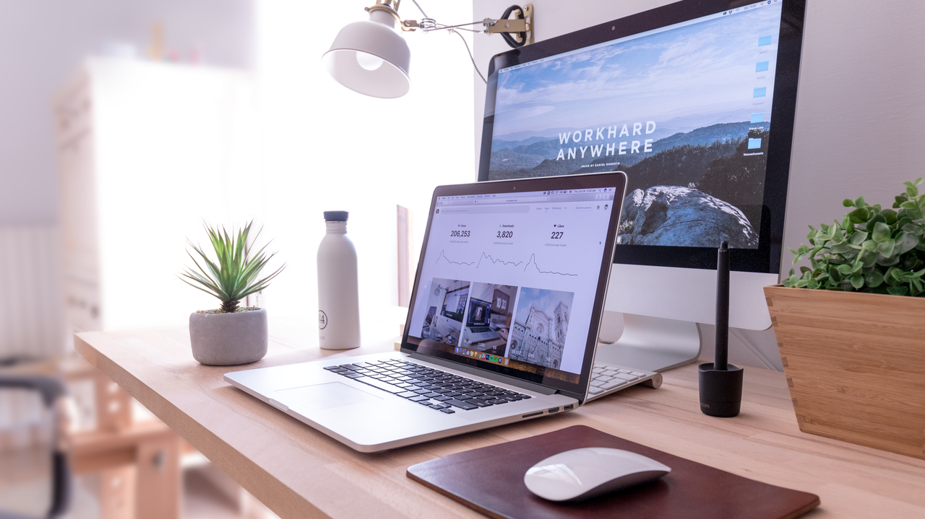
The collected data has been stored in the Comma Separated Value file Zomato.csv. Each restaurant in the dataset is uniquely identified by its Restaurant Id. Dataset credits: Shruti Mehta, Kaggle.

Slide 7

Methodology
K Means Clustering
We use K Means clustering to work on the project for getting meaningful ideas.
The reason for using K Means Clustering is that:
k-means clustering is a method of vector quantization, originally from signal processing, that aims to partition n observations into k clusters in which each observation belongs to the cluster with the nearest mean (cluster centers or cluster centroid), serving as a prototype of the cluster

Slide 8

Results
We obtain a result map, where the clusters are plotted.
Further, we can also define a target cuisine or average spending, according to which a cluster can be recommended to the user.
We can also derive inferences, as to which localities are related based on average restaurant budgets and cuisines.

Slide 9
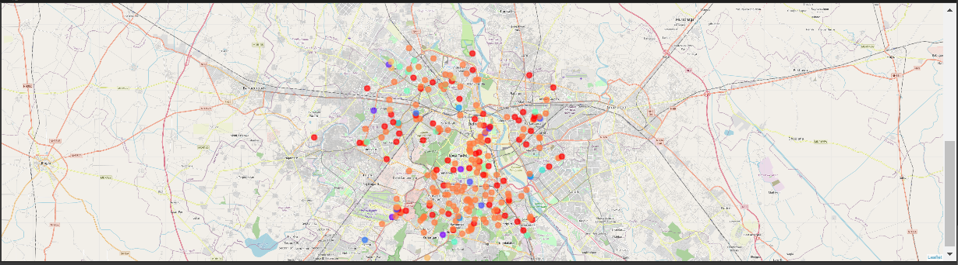
An image of the output is as shown here:
DESKTOP PROJECT
Show and explain your web, app or software projects using these gadget templates.
Place your screenshot here

Slide 10
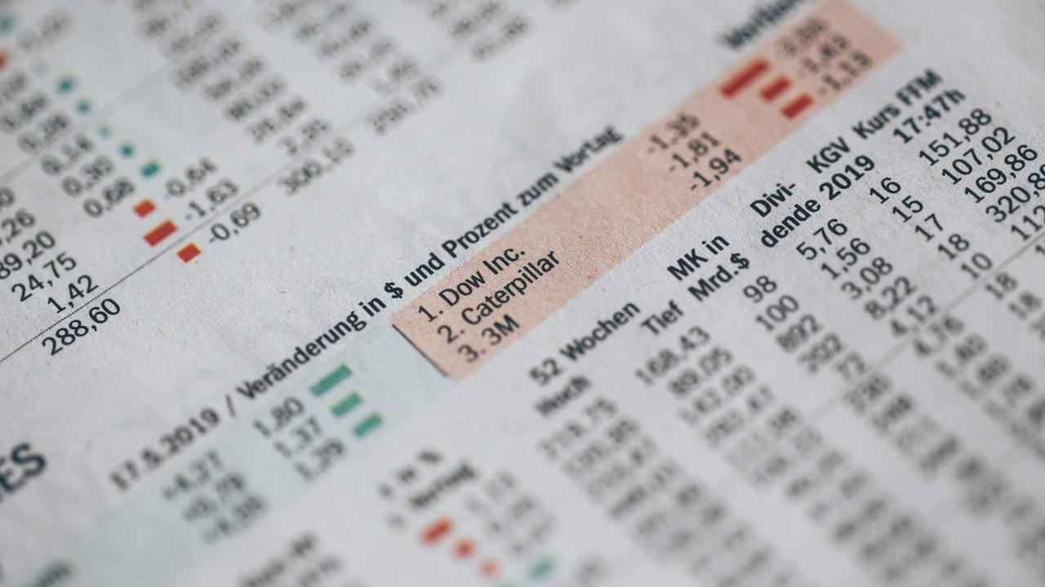
Discussion
We can recommend clusters and localities, based on the defined target cuisine or average spending, and the result list is present in the notebook with sample example, for which results for these recommendations have been derived.
We can also derive inferences, as to which localities are related based on average restaurant budgets and cuisines.

Slide 11
Conclusion
We hereby conclude, that our model identifies similar localities/neighbourhoods based on the aforementioned characteristics/parameters. We can also use the analysis to recommend localities for a new or an upcoming restaurant business.

Slide 12

THANKS!
Any questions?
You can find me at:
neelshah.tech@gmail.com

